Slide 3
How Creativity can Drive Advertising Effectiveness for your Hospital + Building your Brand Voice
Dominic Symes, EVP Staffing Solutions and Chief Revenue Officer
| June, 2023

Slide 4
What are the characteristics of great creative?
Attributes
True to its offering
Speaks to your customers needs
Easily accessible across platforms
Enticing and persuasive
Delivers a clear message
Carefully thought out
Focused and concise
Delivers social proof
Solution focused
Provocative
Written to convert
Memorable
.

Slide 5
What is the effect of creativity in advertising?
Distinctiveness
Creativity creates the distinction between 2 products under the same category.
Nobody counts the number of ads you run; they just remember the impression you make.

Slide 6
How does creativity translate to sales traffic or Hospital foot traffic?
Notes:
Graphs na die page

Slide 7
How does creativity translate to traditional and digital?
When creative is strong, it's the overwhelming driver of in-market success: up to 80% for traditional TV and 89% for digital advertising.

Slide 8
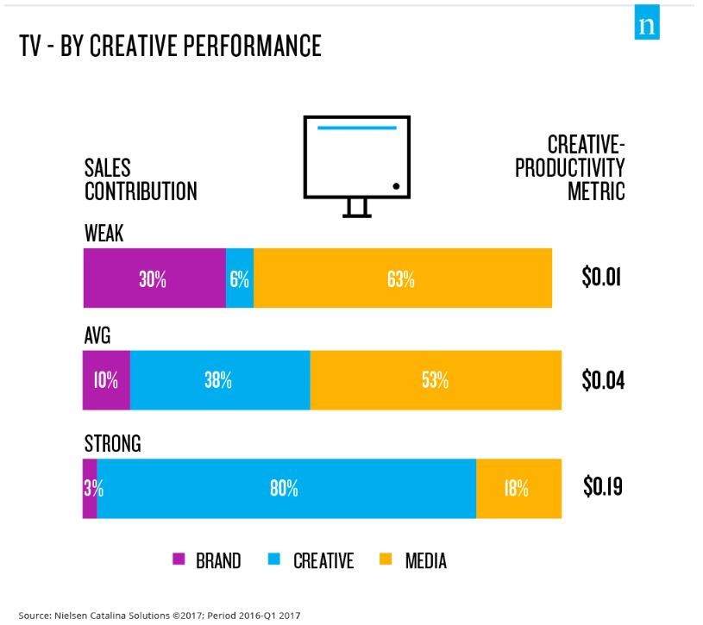
Source: Nielsen Catalina Solutions 2022

Slide 9
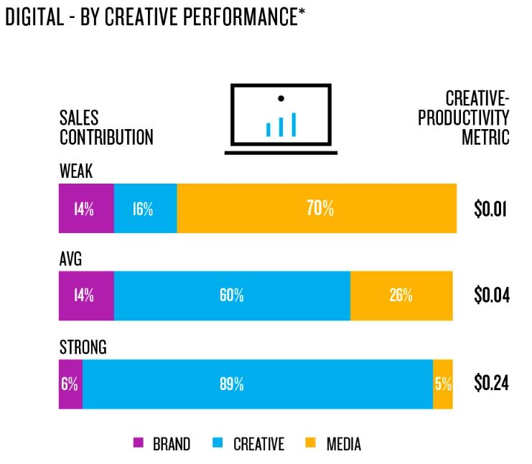
Source: Nielsen Catalina Solutions 2022

Slide 11
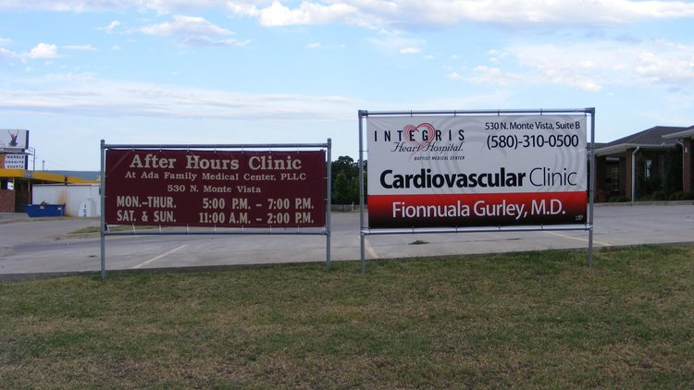

Slide 12
Let's just do some lateral thinking for a second. What if?

Slide 17
Brand Voice

Slide 18
What is a Brand Voice?
Emotional rescue!
Brand voice is the distinct personality a brand takes on in its communication
Is not only what you say to your audience but how you say it.
Tone of voice is the mood or emotion you convey in messages to your audience through specific word choice and writing style

Slide 19
Why is your Brand Voice important?
Using language and style your audience understands builds a connection.
Brand voice guidelines reinforces who we are ( no matter where patients find us)
.
Failure to speak clearly to audiences + poor performance can even turn patients away.

Slide 20
Types of Brand Tones
Set the tone!
Fun tone
Authoritative tone
Edgy tone
Optimistic tone
Bold tone
Approachable tone
Professional tone

Slide 21
Brand Voice Corporate Identity and Design

Slide 22
Let’s have a look at some excellent examples

Slide 23
Dove Soap Brand Voice
Brand Voice: Positivity. Body Positivity. Relatable..

Slide 24
HealthTech Brand Voice
Our culture.
A spirit of collaboration defines our people and our culture.
What are barriers for, if not for breaking? Instead of asking, “Why?” we prefer to ask, “Why not?” Our team is the center of our business and our culture inspires them to innovate, self-develop, and evolve. This not only gets the best out of our team members, but it gets the best results for our clients too.
Brand Voice: Proud. Culture-driven. Servant leadership..

Slide 25
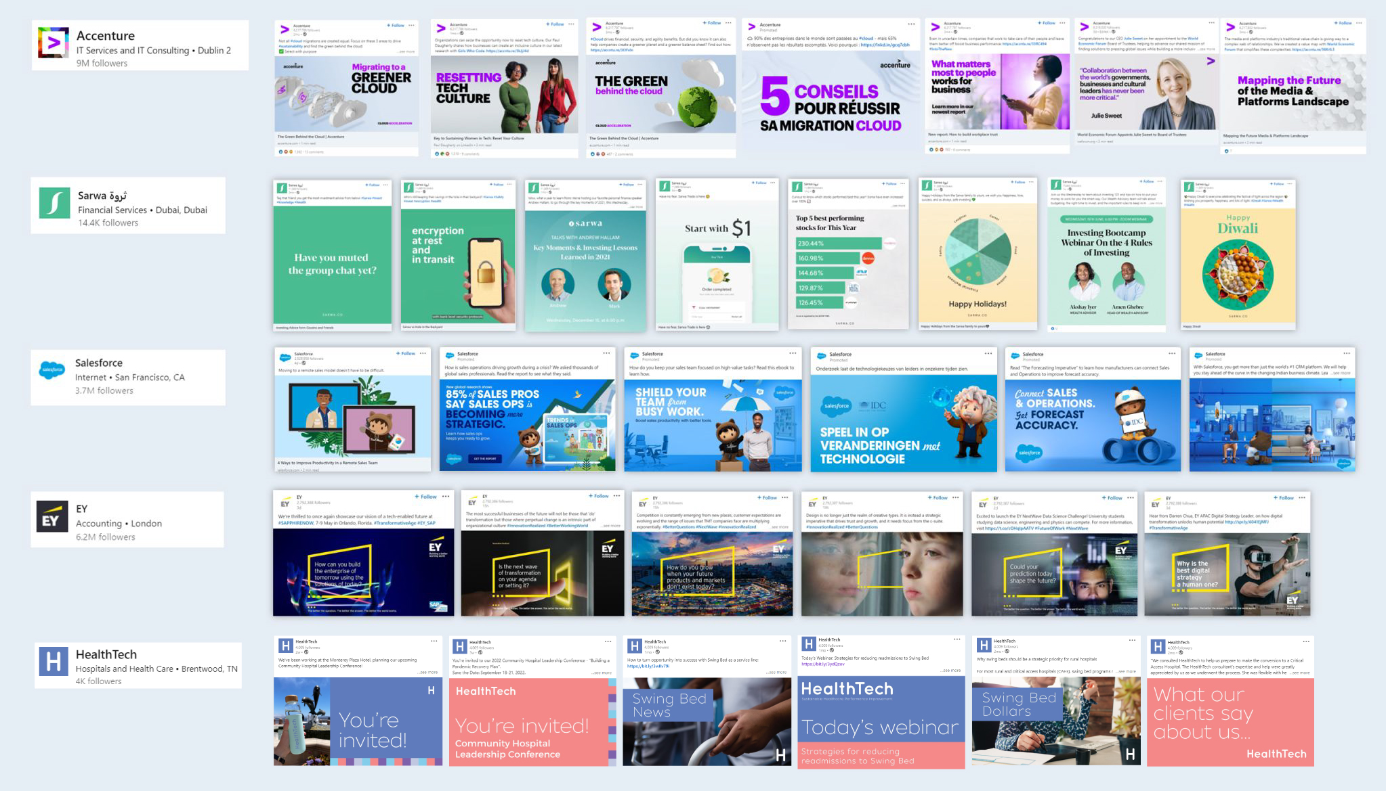
HealthTech Brand Voice
Instantly Recognizable

Slide 26
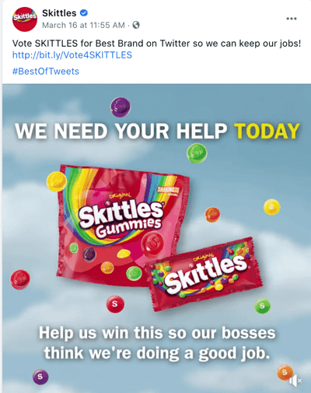
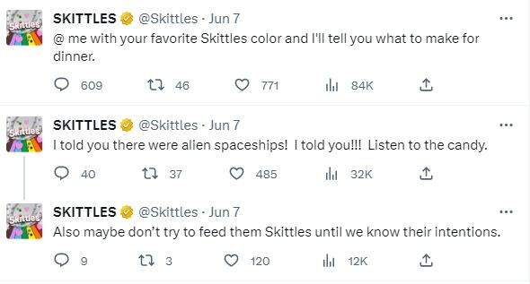
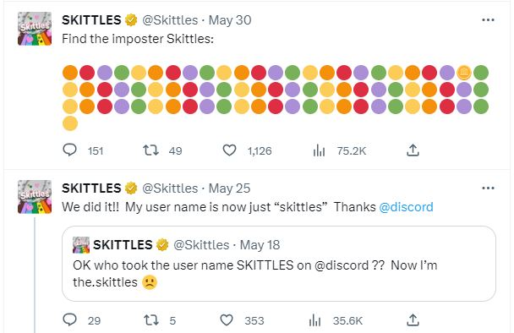
Skittles Brand Voice
Brand Voice: Humorous, cheeky, weird and funky.

Slide 27
Kaiser Permanente Brand Voice
Brand Voice: Personal and caring

Slide 28
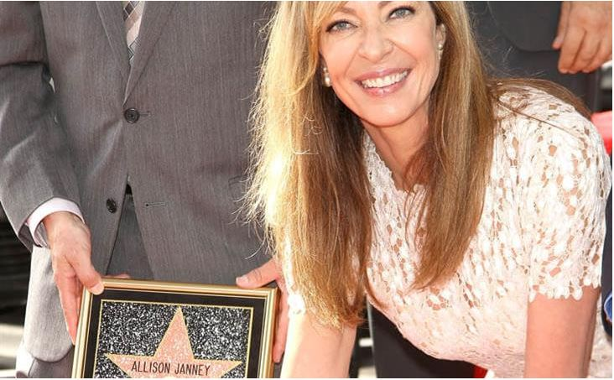
Kaiser Permanente Brand Voice
Allison Janney - Kaiser Permanente Voice Over

Slide 29
Kaiser Permanente Brand Voice
Radio advert
Brand Voice: Personal and caring

Slide 30
How do you go about Creating a Distinct Brand Voice for your Hospital?

Slide 31
Step 1: Start with your Hospital’s Mission
Your hospitals value statement can help you determine some key characteristics of your brand voice.
"The Good Company" (example)
We are completely transparent.
We encourage our customers to understand exactly how our products are made.
We don’t make off-the-cuff statements without backing them up with proper facts.
We detail the environmental footprint of everything we do.
We benchmark ourselves against competing products & brands.
We are completely transparent about our suppliers & partners.
We ask suppliers & partners to provide us with hard proof about their practices.

Slide 32
Breaking Down "The Good Company"
We see these values — transparency, eco-friendliness & modern instead of traditional.
The writing is clear, straightforward & direct to support the brand's transparency values. The writer takes the angle of eco-friendliness in the opinions expressed.
There's a casual, informal tone to the voice, hinting at a company that isn't old-school and doesn't take itself too seriously.
You'll want to consider your own values when creating a brand voice.

Slide 33
Step 2: Determine Your Heart and Soul
What are the biggest truths about the world that your hospital believes in?
What’s the problem that your patient is trying to solve? What are their biggest desires?
What are the demographics of your target audience and how do they consume information?
What’s your competitor’s tone like? What’s unique about your hospital and beliefs and how are you different from the competition?
Which five words represent your hospital the most? And the least?
Which of your hospital's “big truths” connects the most with your audience? Look at your beliefs, map them to your audience, and research how they’re already consuming those ideas.

Slide 34
Step 3: Determine who you don't want to be
Make a Do's and Don'ts List.
Oftentimes, determining brand voice starts by asking: "What don't we want our brand voice to be?"
Figuring out what you don't want your brand voice to be is a critical step in choosing the right voice for your brand.
For instance, perhaps your team brainstorms the following statements:
Our brand voice is not pretentious.
Our brand voice is not too serious.
Our brand voice is not grandiose.
Our brand voice is not unfriendly.

Slide 35
Step 4: Define Your Brand as a Movie Character
Brand Voice Example
If your hospital brand was a movie character, who would it be?
This is a fun exercise that can be super-useful for the creators who will be following your hospital brand voice guidelines.
Why? You’ll give them a concrete example of your hospital brand’s personality, one they can relate to, in very few words.
For instance, say you decide your hospital brand would be Dory from Finding Nemo if it were a movie character.

Slide 36
Step 5: Put Into Action
Lights, camera, action!
Your final step is to put your brand voice research into action and start rolling it out with smart content creation.
Make sure you have your own content creation plan and don’t waste your resources on cheap marketing that might not meet your expectations or deliver on your brand voice guidelines.
So, once you know your brand voice, it’s time for YOU to put it into action, not someone else. This is your hospital, and you’ve got to be the captain of the ship, guiding others to create in alignment with your brand voice.

Slide 37
Our services
Strategy – Solutions - Support
Governance & Strategy
Finance
Executive management & leadership development
Community health needs assessment
Lean culture
Performance optimization & margin improvement
Revenue cycle & business office improvement
AR outsourcing
Recruitment
Clinical Care & Operations
Executive and interim recruitment
CEOs, CFOs, CNOs
VPs and department directors
Continuous survey readiness
Care coordination
Swing bed consulting
Hospital/Health System Services |
HealthTech

Slide 38
Questions?
dominic.symes@health-tech.us

Slide 39
Thank you!

